Slide 1
Introduction to FHIR Mar 1-3, 2016 HIMSS16
Richard Ettema
Lead Consultant, AEGIS.net, Inc.
richard.ettema@aegis.net

Slide 2
This presentation
Original HL7 version can be downloaded at:
http://gforge.hl7.org/svn/fhir/trunk/presentations/2014-01 Tutorials/Introduction to FHIR.pptx
Author: Lloyd McKenzie, Gordon Point Informatics (GPi)
Is licensed for use under the Creative Commons, specifically:
Creative Commons Attribution 3.0 Unported License
(Do with it as you wish, so long as you give credit)

Slide 3
Healthcare Standards
Share healthcare information electronically
HL7 v2 is over 25 years old
HL7 v3 and CDA more recent
Pressure to broaden scope of sharing
Across organizations, disciplines, even borders
Mobile & cloud-based applications
Faster – integration in days or weeks, not months
Notes:
Who

Slide 4
Why FHIR?
HL7 undertook a “Fresh look”
What would healthcare exchange look like if we started from scratch using modern approaches?
Web search for success markers led to RESTful based APIs
Drafted a healthcare exchange API based on this approach – http://hl7.org/fhir
4

Slide 5
FHIR Manifesto
Focus on Implementers
Target support for common scenarios
Leverage cross-industry web technologies
Require human readability as base level of interoperability
Make content freely available
Support multiple paradigms & architectures
Notes:
We don’t actually have a formal manifesto, but these are the principles we adhere to.

Slide 6
The acronym
F – Fast (to design & to implement)
Relative – No technology can make integration as fast as we’d like
H – Health
That’s why we’re here
I – Interoperable
Ditto
R – Resources
Building blocks – more on these next
6
Notes:
9:25

Slide 7

Resources
Defined Structured Data
The logical, common contents of the resource
Mapped to formal definitions/RIM & other formats
Syntax (XML and JSON)
Extensions
Local requirements, but everyone can use
Published and managed
Narrative
Human readable
7

Slide 8
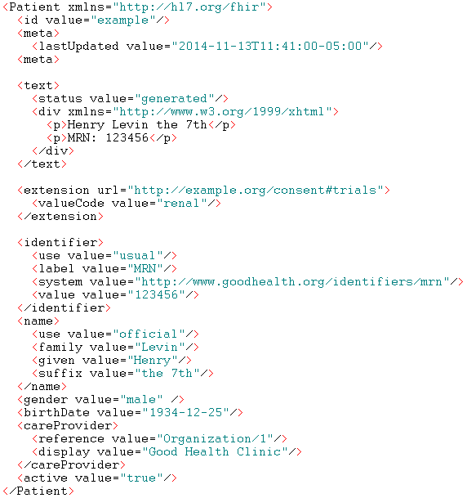
FHIR Identity/Metadata
Human Readable Summary
Extension with reference to its definition
Standard Data Content:
MRN
Name
Gender
Date of Birth
Provider

Slide 9
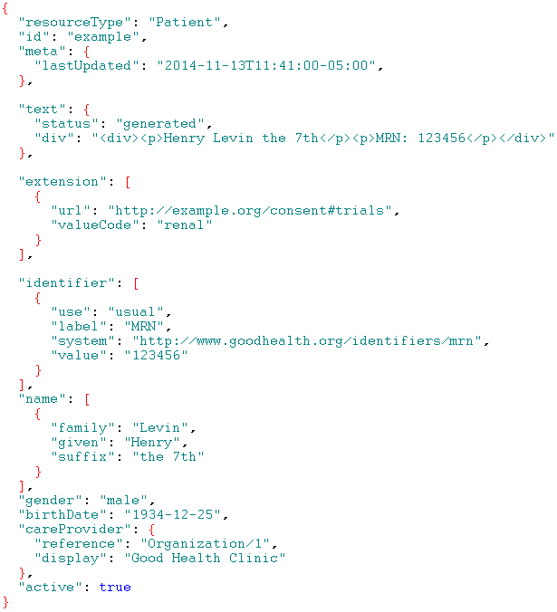
FHIR Identity/Metadata
Human Readable Summary
Extension with reference to its definition
Standard Data Content:
MRN
Name
Gender
Date of Birth
Provider

Slide 10
It’s all about the resources . . .
Building blocks…
Location
Related
Person
Patient
Diagnostic
Report
Practitioner
10

Slide 11
What is a Resource?
Administrative
Patient, Practitioner, Organization, Location, Coverage, Invoice
Clinical Concepts
Allergy, Condition, Family History, Care Plan
Infrastructure
Document, Message, Profile, Conformance*
11

Slide 12
Conformance*
There’s a resource for documenting conformance to FHIR
Can be used for:
Stating how a specific system instance behaves
Defining how a software system is capable of behaving (including configuration options)
Identifying a desired set of behavior (e.g. operation)
To declare themselves “FHIR Conformant”, a system must publish a Conformance instance
12

Slide 13

Human Readable
CDA taught HL7 a very important lesson
Even if the computers don’t understand 99% of what you’re sending, that’s ok if they can properly render it to a human clinician
This doesn’t just hold for documents – important for messages, services, etc.
In FHIR, every resource provides for a human-readable expression
13
Notes:
Even when you think your target will understand all the encoded data, reality is data often gets shared beyond the originally intended context
Allow for exceptions for things like automated device readings, etc.

Slide 14
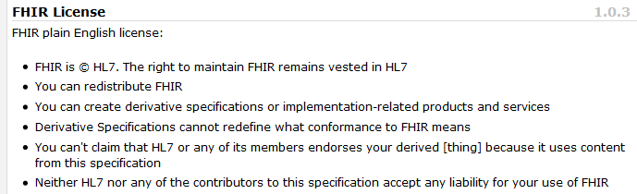
Freely available
Unencumbered – free for use, no membership required
http://hl7.org/fhir
14
Notes:
Was a bigger deal before HL7 decided to open up all IP
full legal text towards bottom of FHIR home page

Slide 15
Paradigms
FHIR supports 4 interoperability paradigms
REST
Documents
Messages
Services
15

Slide 16
REST
Simple, out-of-the-box interoperability
Leverage HTTP: GET, POST, etc.
Pre-defined operations
Create, Read, Update, Delete
Also: History, Read Version, Search, Updates, Validate, Conformance & Transaction
Works best where control resides on client side and trust relationship exists
REST
16
Notes:
URLs, parameters, etc. all defined
Choice of what operations to support
Behavior documented in conformance profile - mandatory

Slide 17
Documents
Similar to CDA
Collection of resources bound together
Root is a “Composition” resource
Just like CDA header
Sent as a Bundle (FHIR Resource)
One context
Can be signed, authenticated, etc.
Documents

Slide 18
Messages
Similar to v2 and v3 messaging
Also a collection of resources as a Bundle (FHIR Resource)
Allows request/response behavior for both request and response payloads
Event-driven
e.g. Send lab order, get back result
Can be asynchronous
Messages

Slide 19
Service Oriented Architecture (SOA)
Do whatever you like
(based on SOA principles)
Ultra complex workflows
Ultra simple workflows
Individual resources or collections (as a Bundle or other formats)
Use HTTP or use something else
Only constraint is that you’re passing around FHIR resources in some shape or manner
Services
19

Slide 20

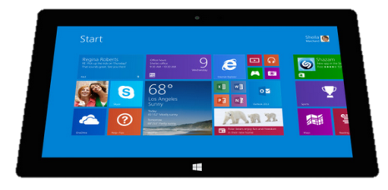
Regardless of paradigm the content is the same
Receive a lab result in a message…
FHIR
Repository
FHIR Message
FHIR Document
Lab System
REST
National
Exchange
…Package it in a discharge summary document

Slide 21

FHIR & other SDOs
IHE
Investigating use of FHIR for MHD (mobile XDS) and PDQm (mobile Patient Query)
http://www.ihe.net/uploadedFiles/Documents/ITI/IHE_ITI_Suppl_MHD.pdf
http://www.ihe.net/uploadedFiles/Documents/ITI/IHE_ITI_Suppl_PDQm.pdf
ONC
Structured Data Capture Initiative to facilitate the collection of supplemental EHR-derived data
http://wiki.siframework.org/Structured+Data+Capture+Initiative
Because FHIR is free and because of how it’s structured, use by other SDOs is certainly possible

Slide 22
Where can FHIR be used?
Classic in-institution interoperability
Back-end e-business systems (e.g. financial)
Regional Health Information Organizations (RHIO)
National EHR systems
Social Web (Health)
Mobile Applications
Near
Term
22

Slide 23
What does FHIR provide?
Resources (building blocks)
Extensions
Methodology
Bundles, Profiles, Conformance
Syntax (XML, JSON)
Human readability
Support for multiple Paradigms
REST, Messaging, Documents, Services
23

Slide 24
Demo and Discussion
AEGIS WildFHIR public site
Client → http://wildfhir.aegis.net/fhirgui
Server → http://wildfhir.aegis.net/fhir
Demonstrate
Patient Resource
Conformance Resource
FHIR Messaging – Clinical Decision Support Immunization Forecasting
In collaboration with the Immunization Information System (IIS) community; this is an example of creating a new FHIR Profile
http://openimmunizationsoftware.net/forecasting/forecasting.html
24

Slide 25
Clinical Decision Support - Immunization Forecast
The following is taken from the Open Immunization Software (OIS) Project:
http://openimmunizationsoftware.net/forecasting/forecasting.html
Vision for National Forecasting
Clinical Decision Support (CDS) is critical for clinical professionals, parents and public health agencies to make correct decisions on what vaccination a patient is due to receive. Most particularly clinical professionals need:
CDS at time of encounter or whenever they view a patient's vaccination history.
CDS that is accurate, meeting ACIP guidelines and other best practice recommendations.
In addition to this immunization information systems need:
Ability to control and manage their CDS software at the highest degree possible.
System that has been tested to meet ACIP and other guidelines.

Slide 26
Clinical Decision Support - Immunization Forecast
All of these goals can be reached by having all CDS software systems:
Support a single open standard for external systems to request and receive CDS guidance.
Connect to a national testing system for comparing and verifying CDS performance.
With these two systems in place, and clinical professional who uses an EHR or a public health agency could select any CDS forecaster, at any time, to provide CDS guidance, using the information from the national testing system to determine if the CDS software meets their expectations.

Slide 27


Clinical Decision Support - Immunization Forecast
Custom Interface*
Local
Forecaster
Custom Interface*
State
Forecaster
Physician
EHR System
Custom Interface*
*There is a need for a national standard for Forecast interfaces.
Regional
Forecaster

Slide 28

Clinical Decision Support - Immunization Forecast
Local
Forecaster
Standard Interface*
State
Forecaster
Physician
EHR System
*HL7 FHIR Messaging used in a Proof of Concept.
Regional
Forecaster

Slide 29




Clinical Decision Support - Immunization Forecast
HL7 FHIR Client
HL7 FHIR Server
TCH Forecaster
HL7 FHIR Client
TCH Forecaster
with HL7 FHIR Message Interface

Slide 30
Contact Us
AEGIS.net, Inc.
2275 Research Boulevard, Suite 500
Rockville, MD 20850
www.aegis.net
Richard Ettema
Lead Consultant
richard.ettema@aegis.net
(703) 893-6020
Mario Hyland
Senior Vice President
mario.hyland@aegis.net
(703) 893-6020 x707
(301) 529-5466 (c)
30

